Slide 1
TechnoUtsav- TechE
Round 2- Phase 3 : Working Prototype
Team Name: UIET_BigOh_3
College: University Institute of Engineering and Technology

Slide 2

Problem Statement:
To build a Hadoop based system that collects news articles from various social media, blogs, online newspapers etc, analyses and summarizes the result to present relevant information from various platforms in a compact form.

Slide 3
Quantitative Impact
Information and Communication Technologies have grown rapidly around the world and advance Internet technology have given mass media a new shape, growth of online media have been noticed in the last 10 years.
According to the OECD, around 5% of all internet visits are related to reading news online.
Now the digital media has become the inherent part of modern society and become a challenge to the print media. Many people nowadays are accessing Internet for updated news in any place and at any time.

Slide 4

Market Growth

Slide 5
5786 online newspapers host the web from 178 nations.
USA ranks first in the list while India occupies the 4th position. The results show a mounting drift of online newspapers especially among the developed nations.
Overall, a compound annual growth rate (CAGR) of 28.29 per cent is observed over a period of 14 years (1996 to 2009).
Use of mobile devices for news continues to grow. As of spring 2017, 45% of U.S. adults often get news on a mobile device, up from 36% in 2016 and 21% in 2013.

Slide 6

Online Newspaper Vs Printed Newspaper

Slide 7
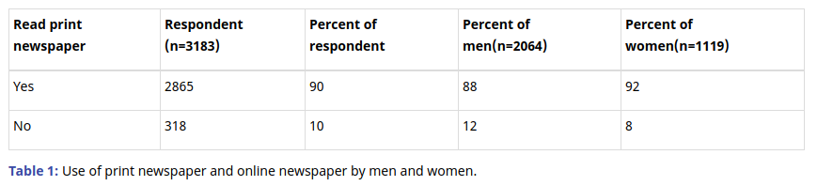
From the data it can be interpreted that there is a need for more online newspaper or media in India for the displacement effect from printed media to online news to be high.
Only 10 percent of the respondents have stopped reading the traditional media (newspapers). While majority (90 percent) of online news consumers is using traditional media for the news, interestingly women respondents are reading both the medium higher (4 percent) than men respondent.

Slide 8
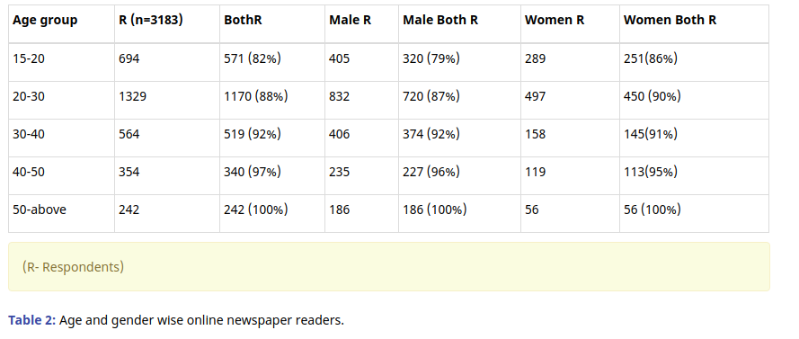
The Table 2 shows the younger age groups readers are much active in online news, as 82 percent respondent of 15-20 age group are reading online newspapers and print medium, 18 percent youth have reduced using print media. Print has start losing young readers. 12 percent of 20-30 age group and 8 percent of 30-40 age group readers have reduced their interest to read print newspapers, they prefer to read online newspapers.

Slide 9
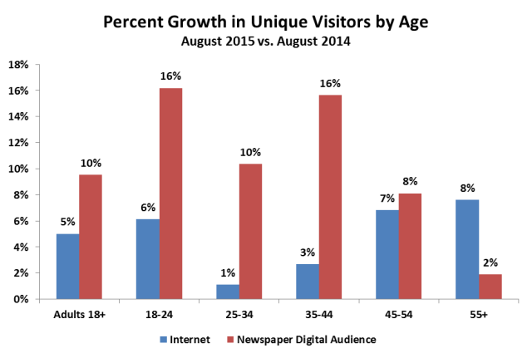

Slide 10

The given application will play an important role in increasing the displacement from the printed media to the digital news platforms.
It provides a single platform for the readers to go through the summarized form of the related articles from some of the biggest online newspaper websites, social media sites, etc.
People want news on demand, and to control and customize content, time and the medium itself. Our application does it for them.

Slide 11

Time Spent Reading
The average amount of time spent reading newspapers fell more than 25% globally from 2010 to 2014
The amount of time spent reading newspapers across the world averaged 16.3 minutes per reader a day last year, down 25.6% from the 21.9 minutes daily average in 2010.

Slide 12
By 2017 the global average will be just 14.1 minutes a day, a 35% fall from 2010 levels, according to a new report by on media consumption by ZenithOptimedia.
Online readers make brief visits to the news sites several times a day with the expectation of obtaining a quick overview over the latest events.
Therefore, an application that is fast and outlines all the trending topics in a single view, will be adopted more by the people.

Slide 13
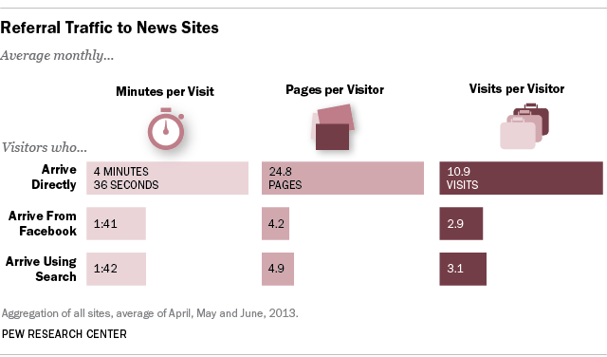

Slide 14

Data Storage
As the application scales, and a need for various perspective arises, a large storage technology is needed to store the articles from hundreds of online news sites and then process them.
Using Hadoop Distributed File System large quantities of data can be stored from multiple sources. This makes the product scalable and reliable.

Slide 15

Qualitative Impact

Slide 16
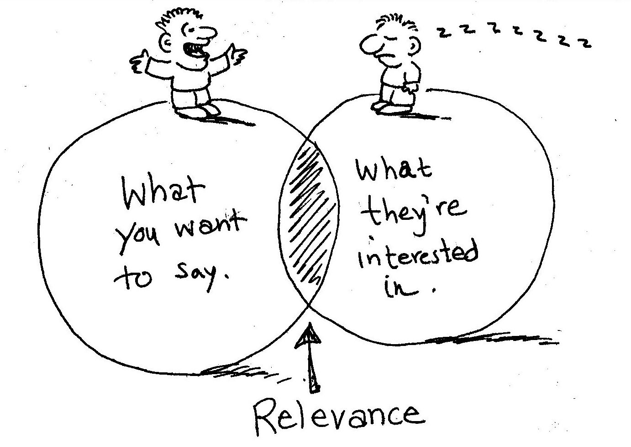
Relevant News
Collecting news articles from some of the most trusted and reliable sources of news like IndiaToday, BBC News, etc.
A summarized version of various perspectives.
Getting to the Users what they exactly want to know.
No heavy content that needs high speed internet.

Slide 17
Fake News
Fake news’ was the Collins dictionary phrase of the year in 2017, just as experts warned that the term has become misleading and unhelpful. From an audience perspective, the term covers a multitude of sins – crystallising audience concerns about biased and shoddy journalism, political spin, misleading online advertising, as well as deliberately fabricated stories distributed via social media. There will be no quick solution to this complex mix of different but related problems.
But if the news is collected from various sources and analysed for only the majority perspective, there are less chances of fake news being published.

Slide 18

Processing Time
Reading an online newspaper is something you do in much shorter breaks, perhaps between two emails, usually in your office in the early morning, or during lunch. Therefore, readers will not have the patience to wait long for the processed articles.
In the given product, all the articles will be processed and summarised in the minimal time using Distributed Processing over HDFS.

Slide 19
User Specific Suggestions
The data for each user can be stored and can be used in future to give user specific suggestions regarding the type of news, events or stories they might be interested to read.
Reduces the searching time for the user.
All you need to read will be presented on a single click!

Slide 20



How it works
Step 3
Step 2
Step 1
The unified and summarized output is displayed to the user.
Search keyword and, stores and processes the related articles using HDFS.
Enter the query.

Slide 21

THANK YOU!

